Slide 1
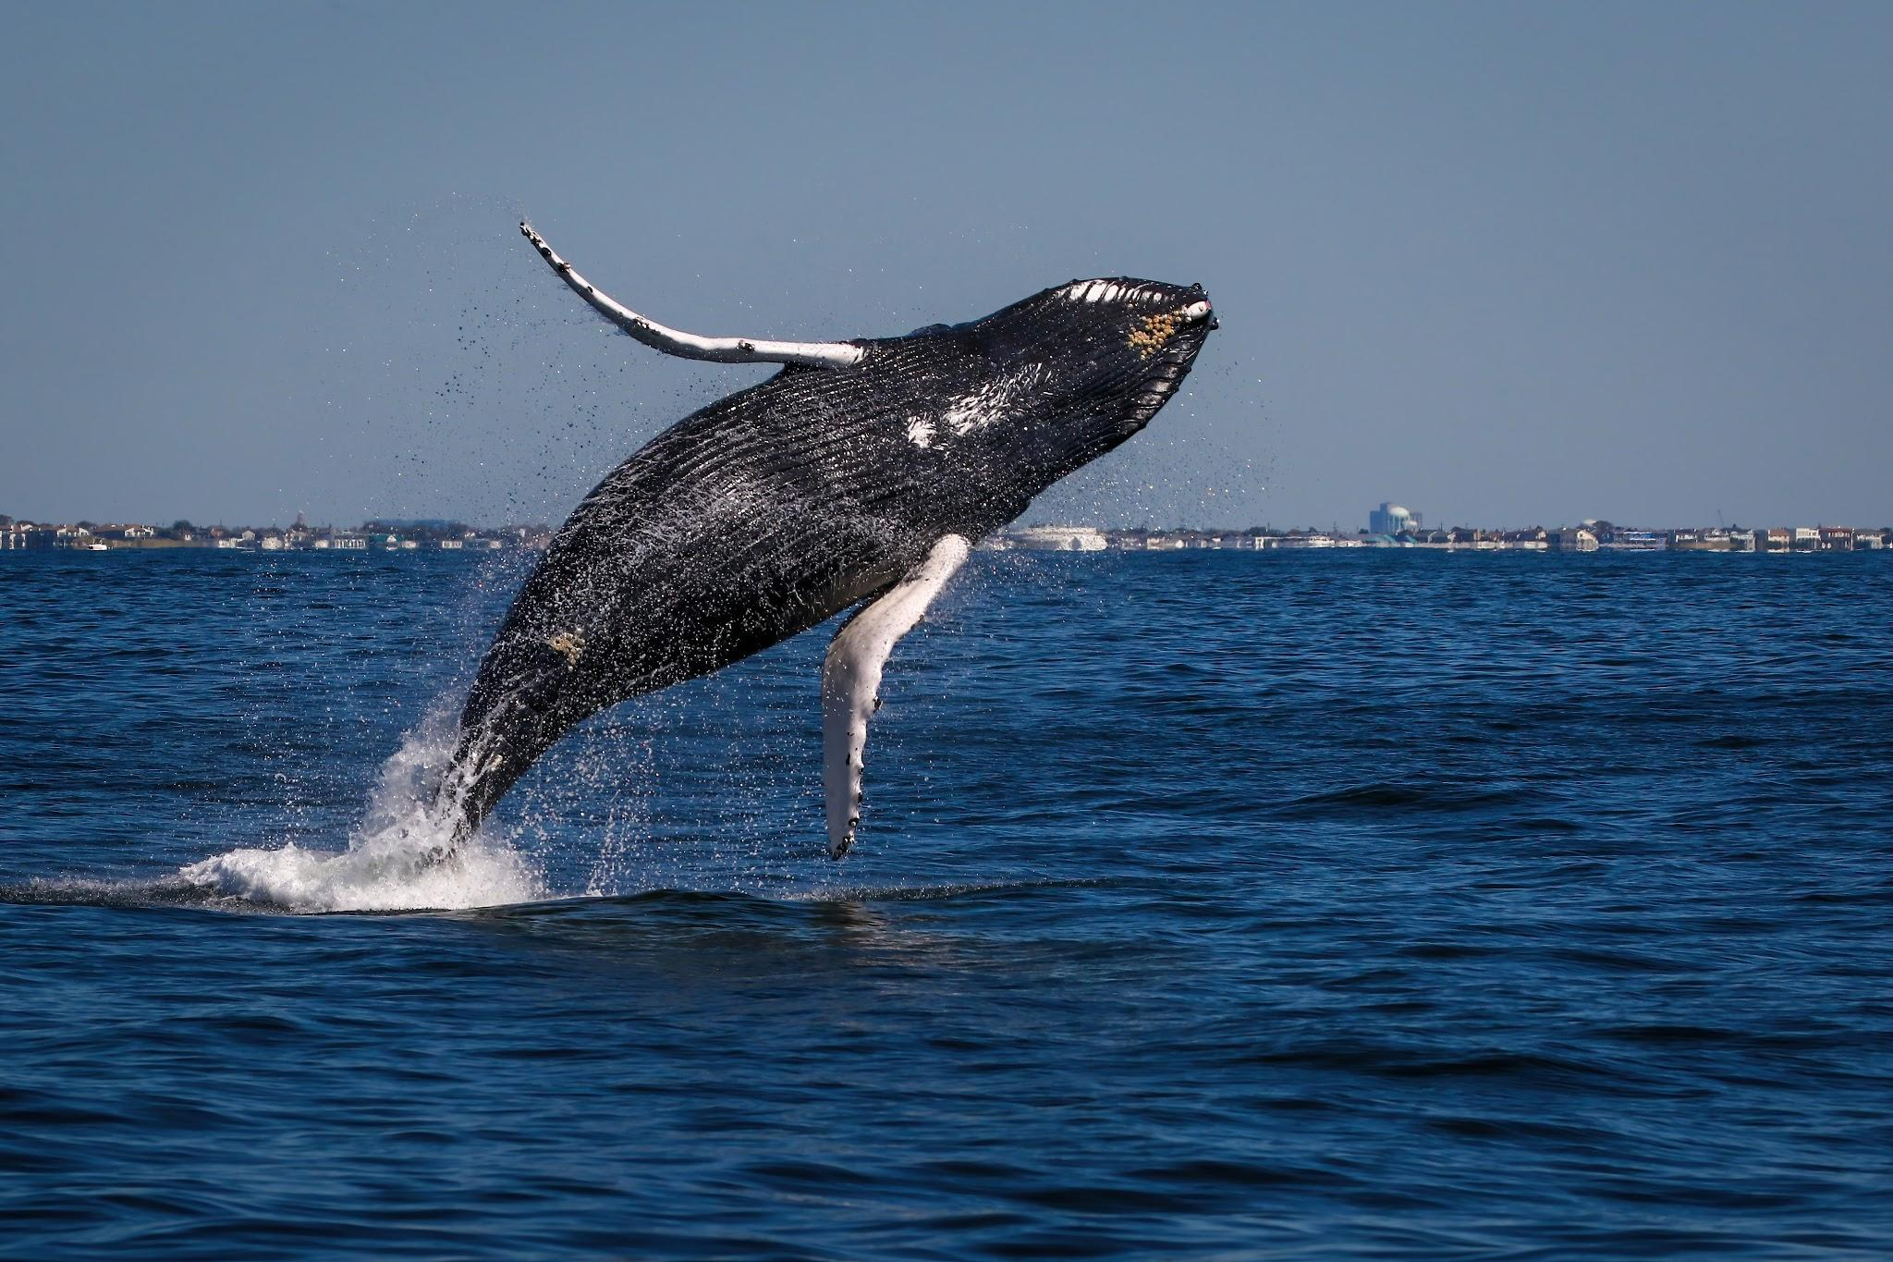

Eyes on the Water
Creating Safer Seas for Everyone:
A Guide for Responsible Boaters
Notes:
Speaker Notes: Even seasoned captains may be new to the recent surge of whales sharing our waters, so it is strongly recommended that instructors take the 20 minutes to complete the free Boating with Whales course (QR on slide 1) BEFORE using the slides in this presentation. Being familiar with the content in the course will help guide instructors through questions they/the participants may have about safely boating around wildlife, but it will also help raise awareness that our boating experiences are changing-captains and crew have responsibilities that may not have included watching for whales in previous years. NOTE: Upon completion of the Boating with Whales course, a downloadable and printable certificate is provided.

Slide 2
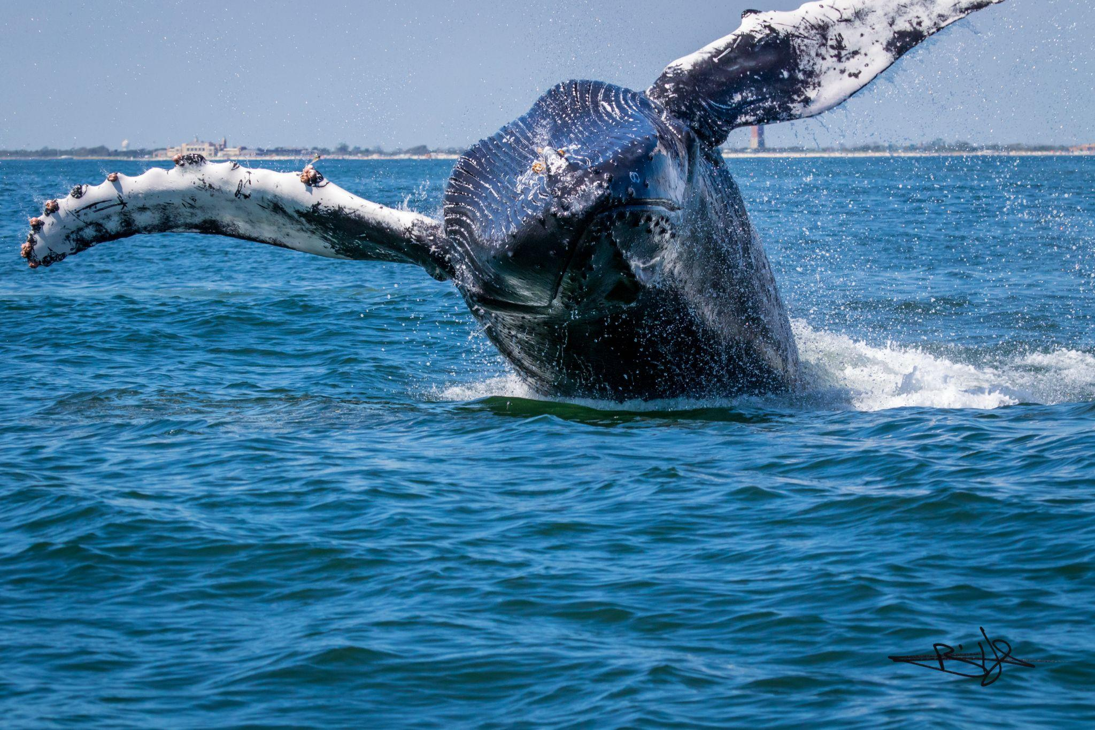
Learning Goals
Identify whales in our area
Recognize signs of whale presence
Understand vessel strike & entanglement risks
Follow safe & legal boating practices
Report whale sightings (when & how)
Notes:
New York's coastal waterways are teeming with marine life, and as they follow their food, whales are more common here now than they've been in decades! Whether you're fishing, cruising, or simply enjoying the ocean, knowing how to share the water safely with whales protects both you and these incredible creatures.

Slide 3
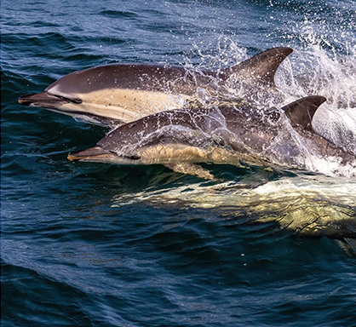
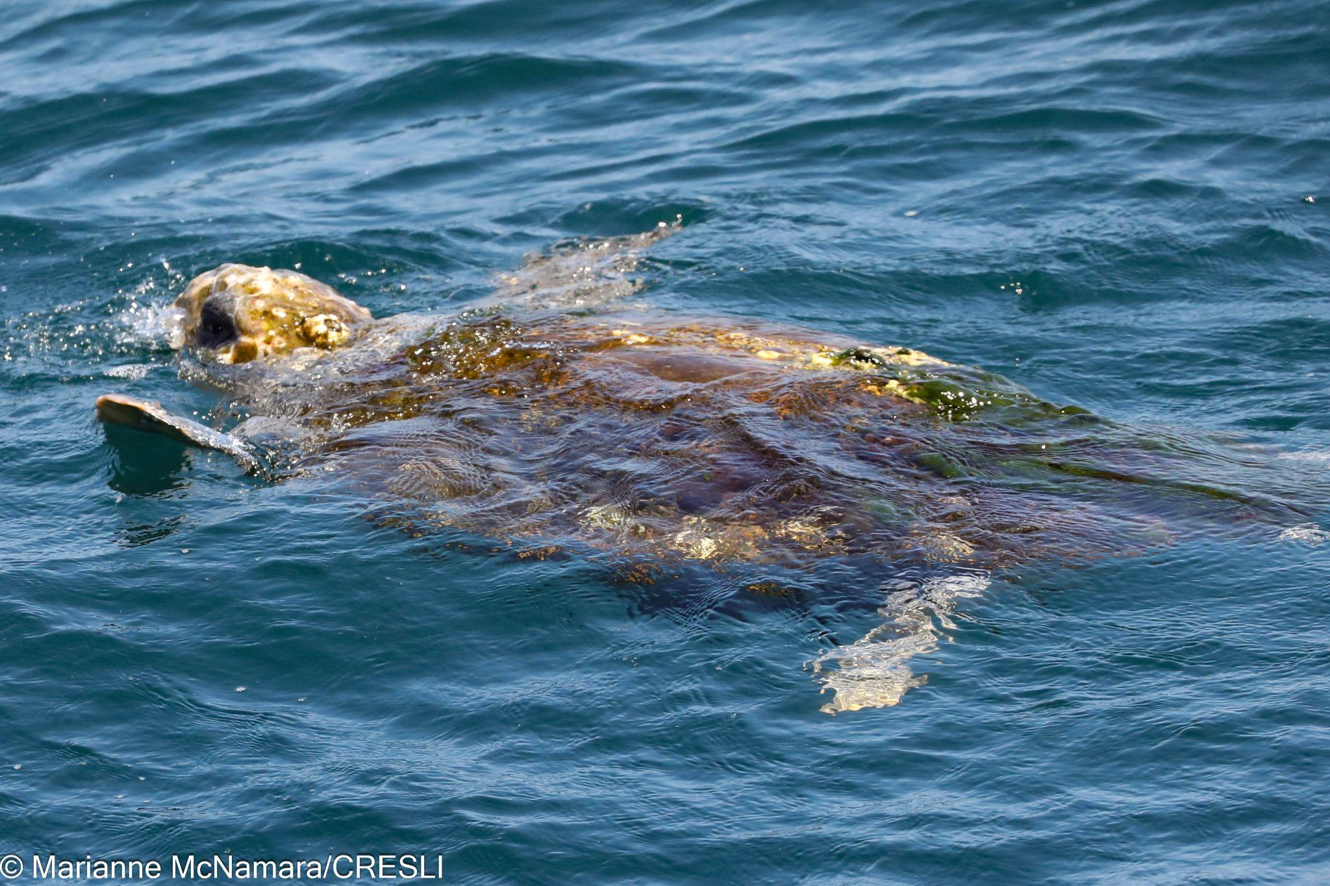
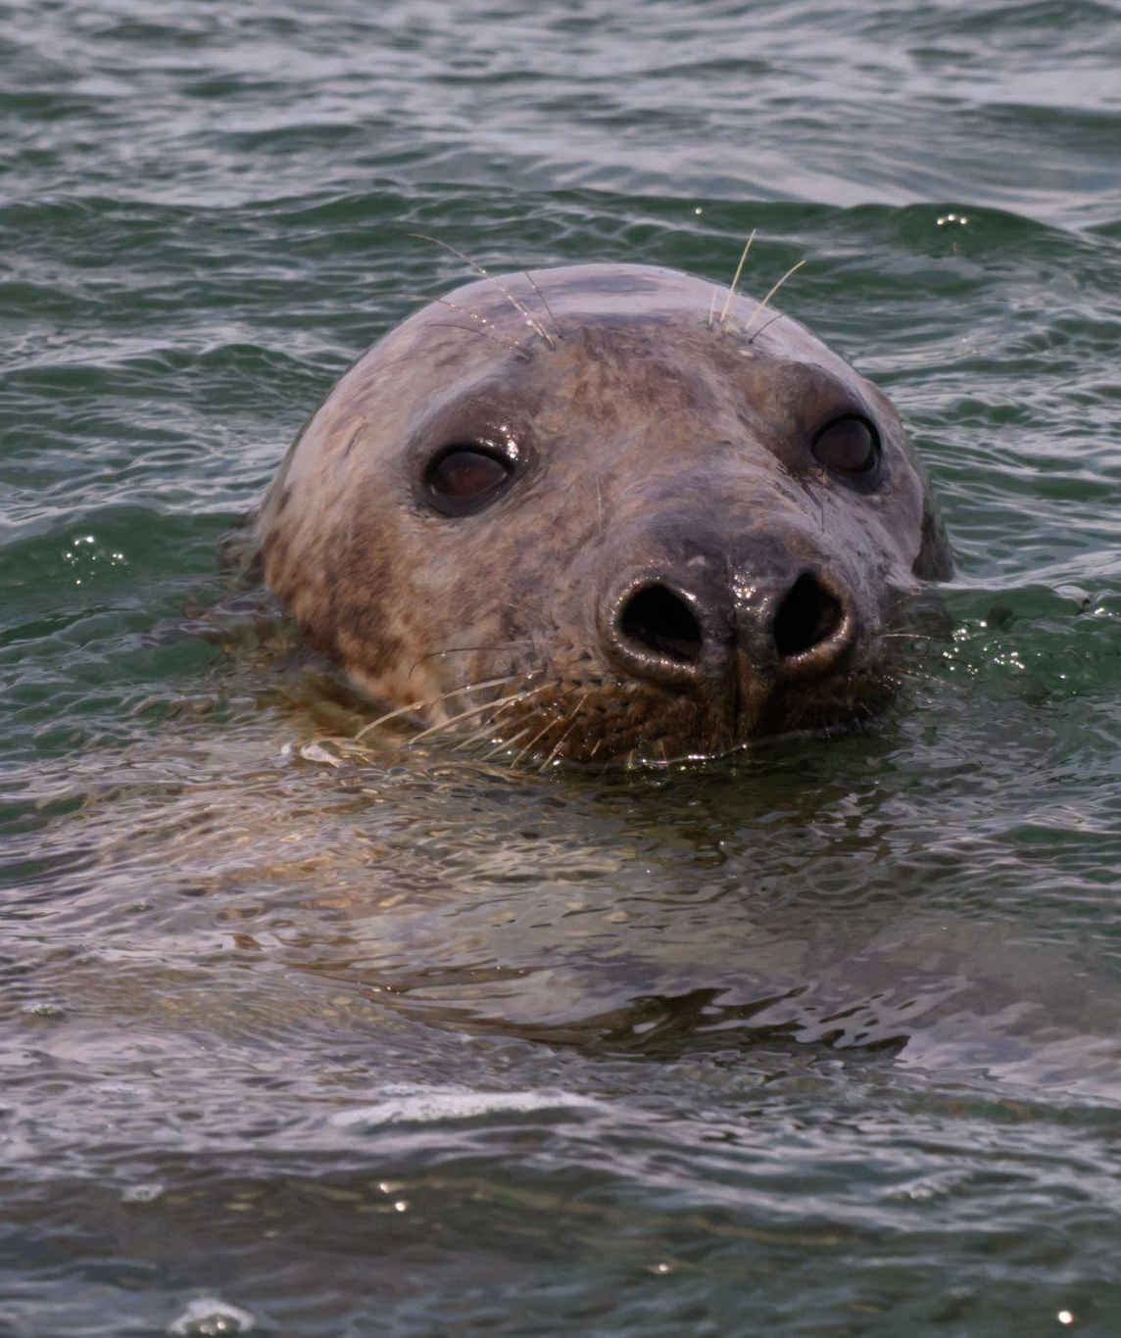
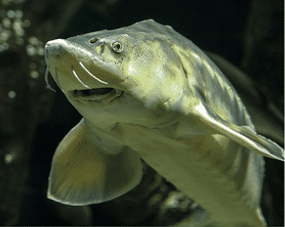
“At Risk” Neighbors
And, of course,
various species
of fish!
Sturgeon
Dolphins
Sea Turtles
Seals
Notes:
As any boater knows, in addition to whales, our coastal ecosystem is rich with diverse species. These are just some of the species that spend time at the surface, and also are known to experience boat collision risk. Understanding your marine neighborhood helps you stay safe and respectful. Each species plays an important role in the ocean ecosystem. The vibrance of our waterways is the result of many years of conservation efforts—and it's our shared responsibility to protect it.

Slide 4
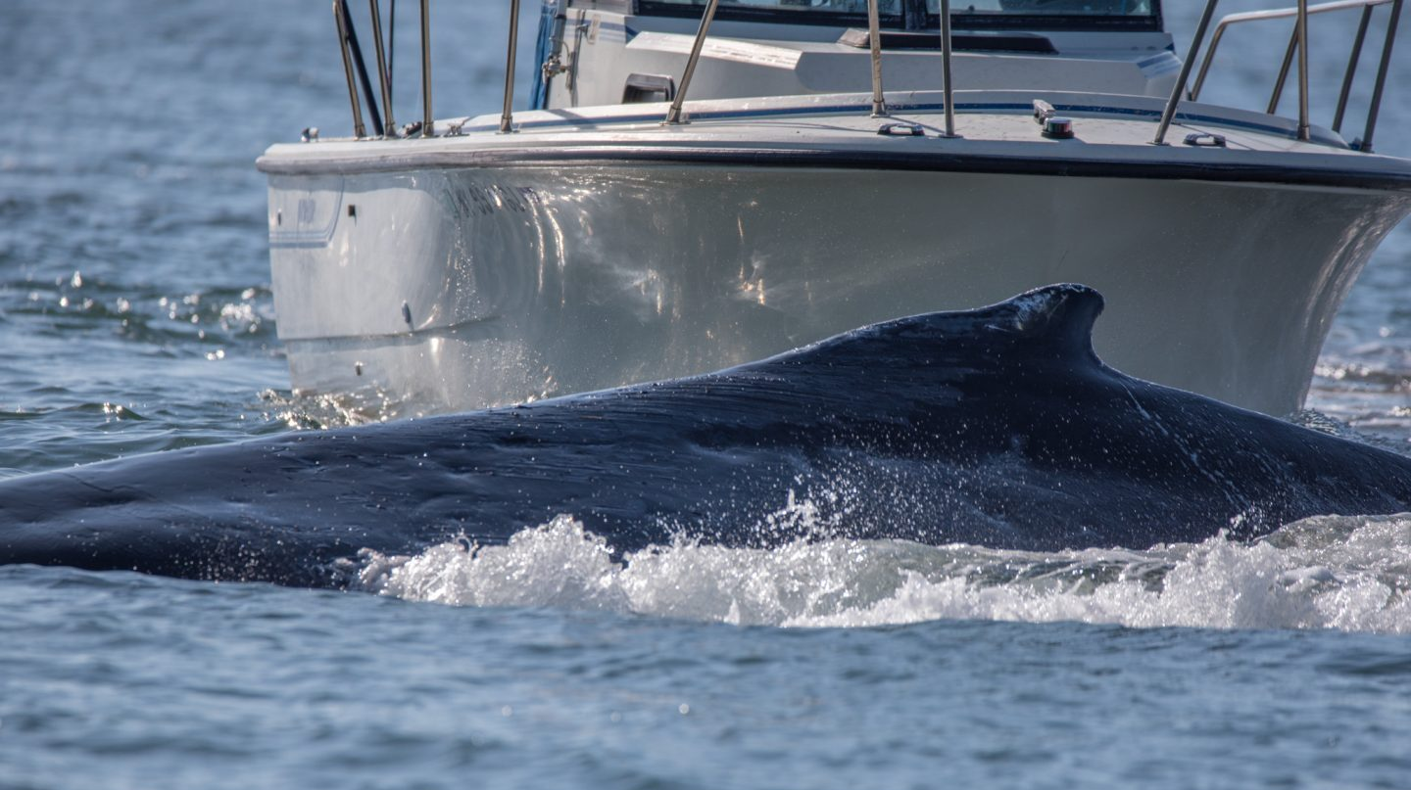
Giants Below
Why it Matters
Whales are protected by federal law
Some species are critically endangered
Understanding whale behavior keeps everyone safe
Your actions directly impact whale survival
Notes:
Several whale species feed or pass through our waters year-round. Despite their massive size, these giants can be surprisingly hard to spot, even in shallower waters. Every year, collisions between boats and whales cause damage to vessels, and injure or kill both whales and boaters.

Slide 5
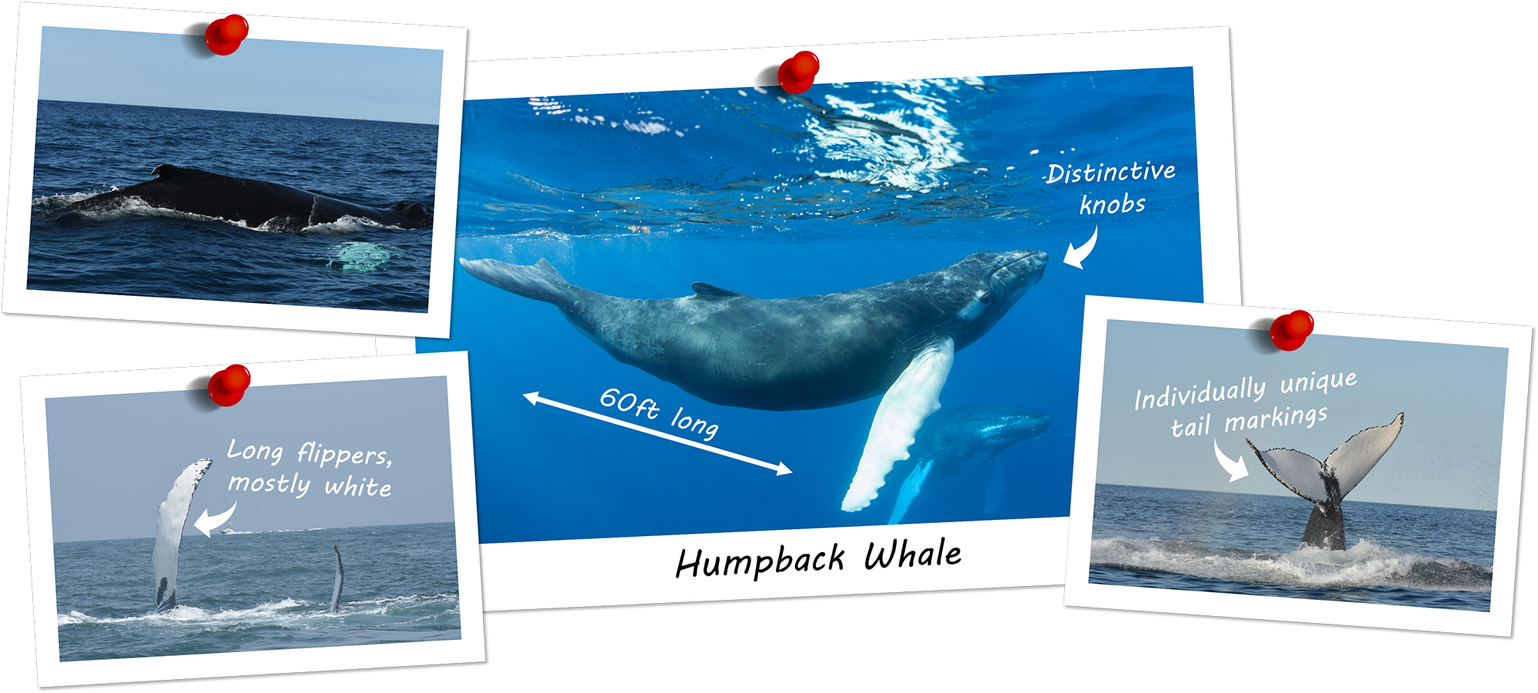
Humpback Whales
Key Features
Length: 60 feet
Distinctive knobs on head & snout
Long pectoral fins (mostly white)
Individually unique tail markings
Behaviors
Frequently observed chasing bait fish nearshore
May enter inlets, bays & harbors
Spectacular lunge feeders
Known for breaching & acrobatic displays
Notes:
Humpbacks are typically the largest of the whales most commonly seen by boaters in our waters.

Slide 6
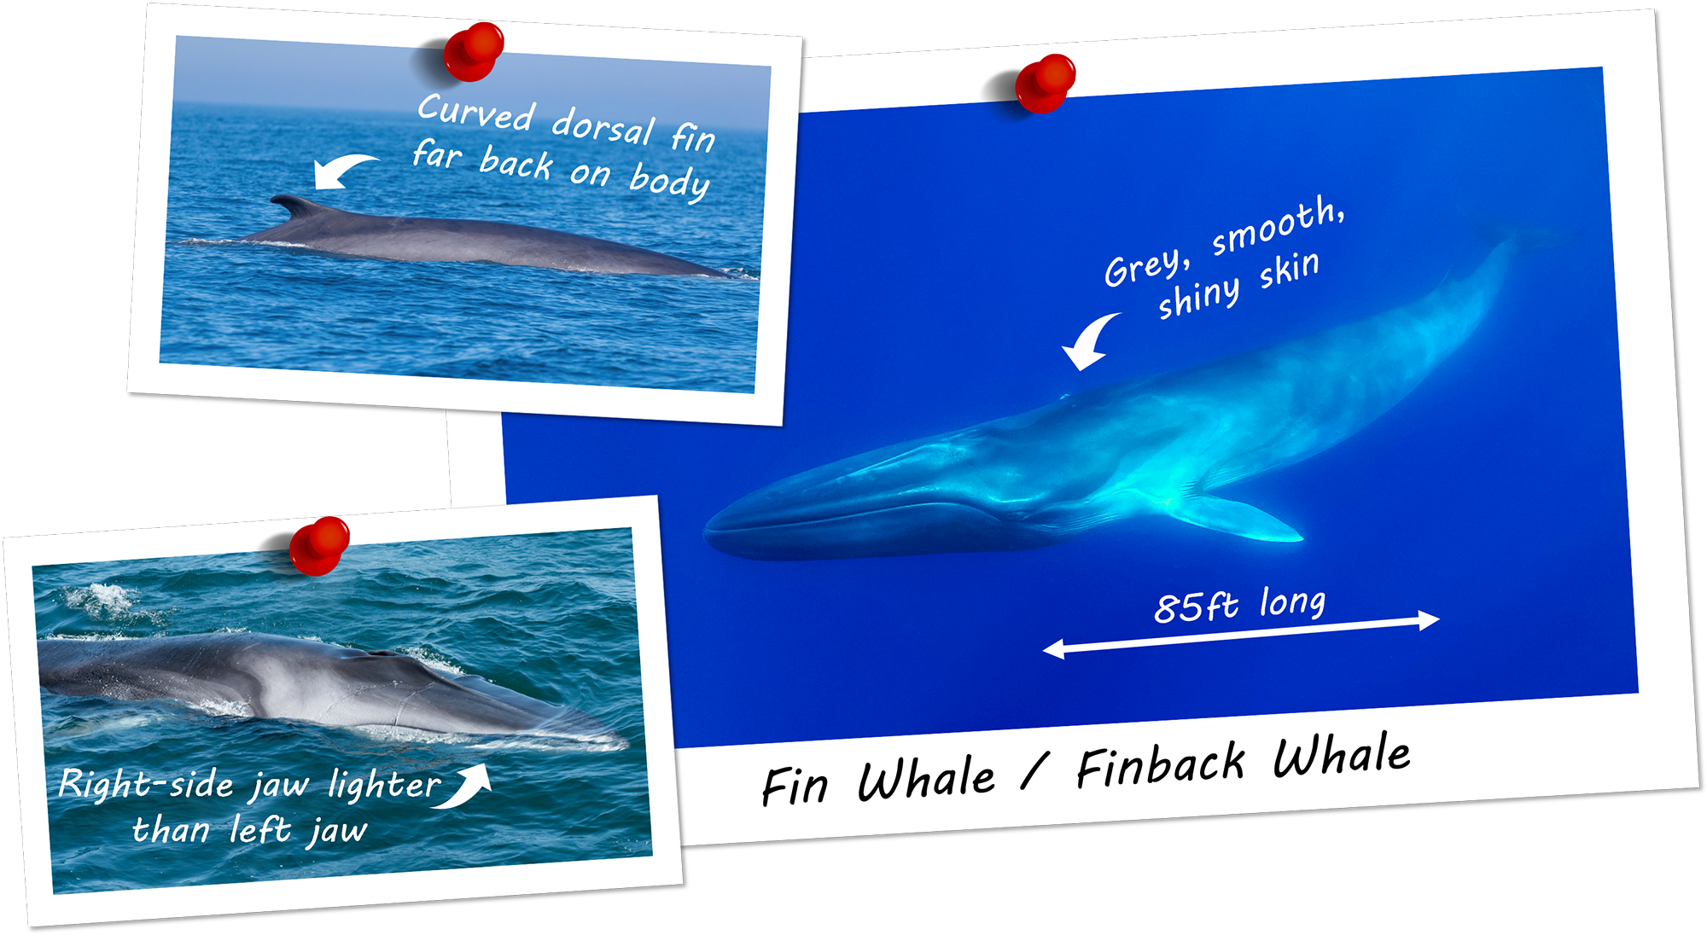
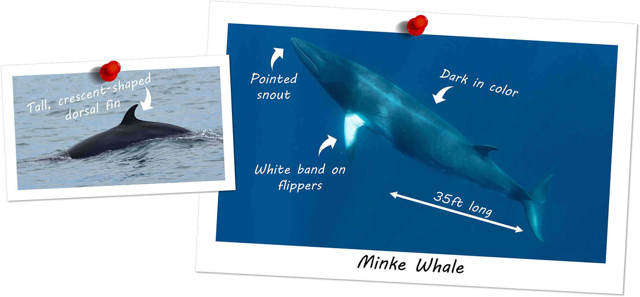
Fin & Minke Whales
Fin Whales
Length: 85 feet
Curved dorsal fin far back on smooth, shiny gray body
Right jaw lighter than left jaw
Fast! Tail rarely surfaces
Minke Whales
Length: 35 feet
Tall, crescent-shaped dorsal fin
Pointed snout & white band on flippers
Smallest baleen whale species
Notes:
After humpbacks, fins (or finback) and minke whales are the next largest whales most commonly seen by boaters in our waters.

Slide 7
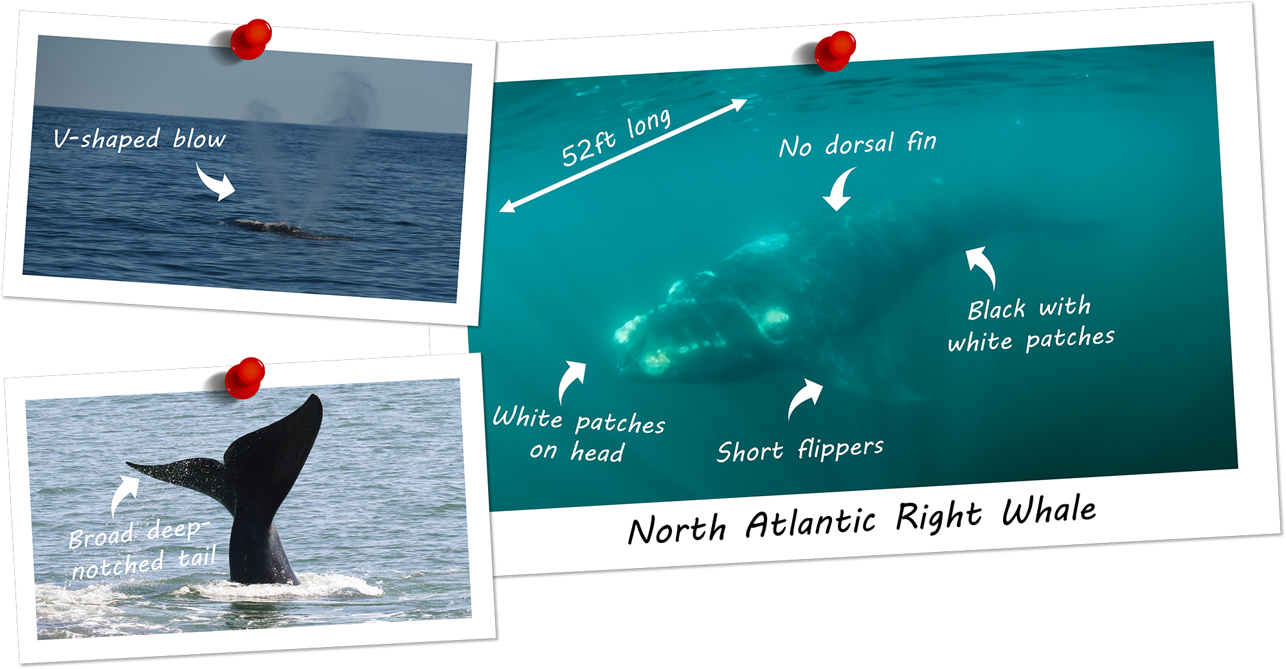
North Atlantic Right Whales
Key Features
Length: 52 feet
Distinctive V-shaped spout spray
Broad, deeply notched tail
No dorsal fin, short flippers
Black body, white patches on head
Critical Status: Less than 400 left globally
Found near NY from nearshore out to the Hudson Canyon
Notes:
Although sightings of these whales are rare due to their critically endangered status,our waters are a favorite of North Atlantic right whales, so keep an eye out for them! By reporting sightings to the authorities, boaters play an essential role as allies in their conservation and protection, since there are less than 400 of them left globally.

Slide 8
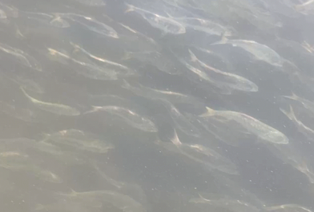
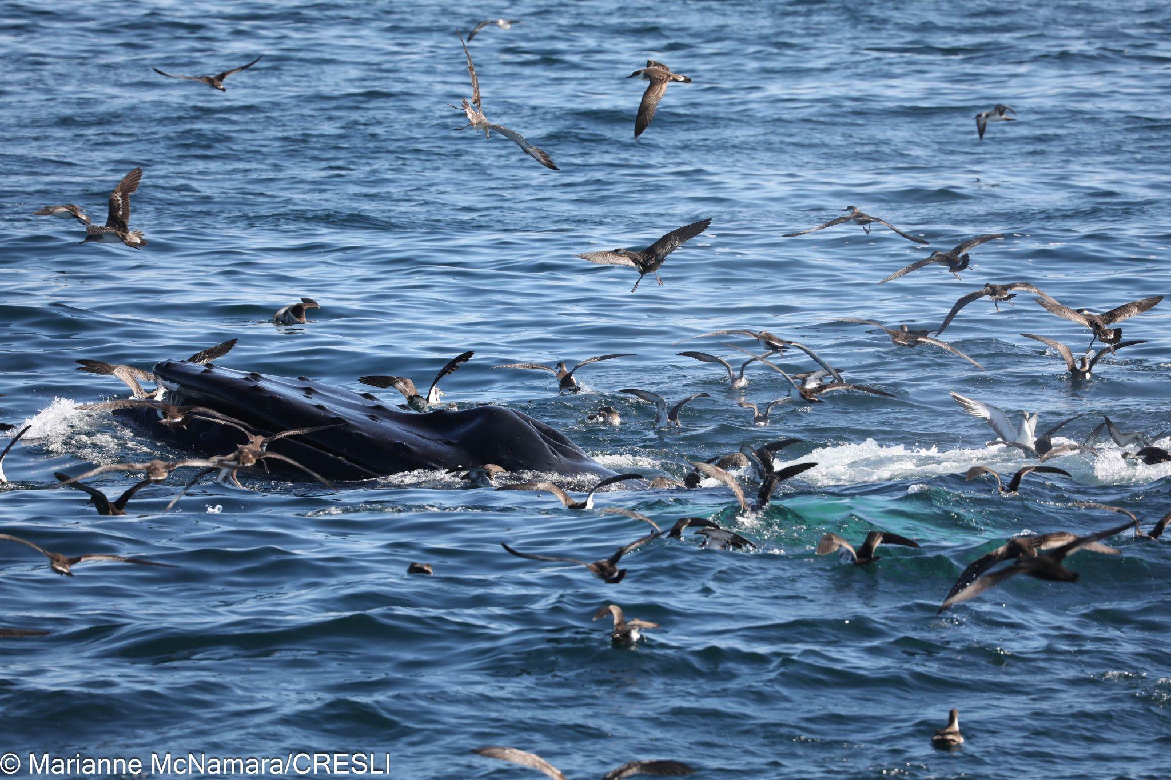
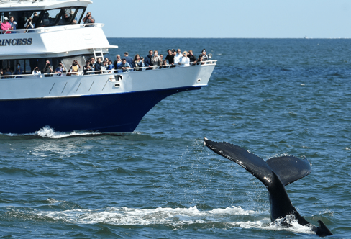
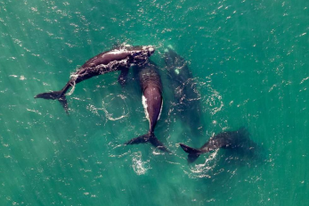
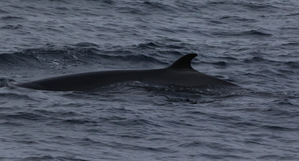
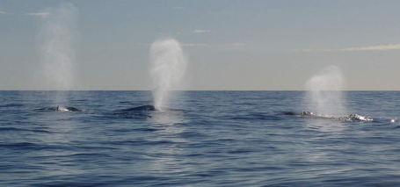
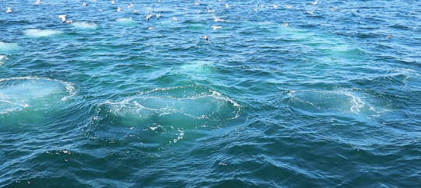
Keep Your Eyes on the Water
Bait
Baitfish schools showing nervous behavior often signal nearby whales feeding on them.
Birds
Many seabirds & whales feed on the same food, so if you see birds, chances are, whales are near.
Boats
Buddies
Look for clusters of fishing & wildlife viewing boats, which signal nearby whales.
Many whales are social feeders—seeing even one whale or other marine life feeding can signal others are close.
Any object breaking the surface of the water can be a navigation hazard, including the back of a whale!
Humpback whale bubble clouds signal that the whales are about to feed near the surface.
Whale spouts are visible from far away on a clear day, so keep an eye out for them!
Backs
Blows
Bubbles
Notes:
Important reminder: Whales can stay underwater for 10 minutes or more and may surface suddenly! Even if you are doing everything right, the best way to protect your passengers, whales, and your boat is to have all hands on deck keeping an eye out for all the “B’’s.Once you or a crew member on your boat spots any of these “B’s”, enlist all hands on deck to increase vigilance-be safe to protect life and property.

Slide 9
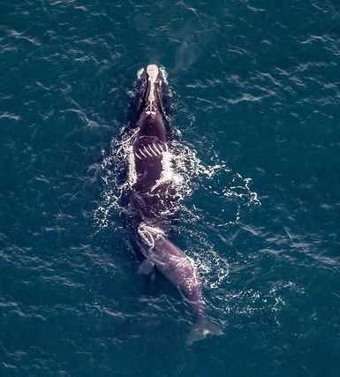
Vessel Strike Dangers
Why right whales are especially vulnerable
Dark coloration & lack of a dorsal fin make them hard to spot, even for experienced boaters
Spend much time at or just below the surface
Less "splashy" than other whale species
Prop Scars on Mother
Nursing Baby
The Reality: Close calls are common. When whales are feeding, resting or nursing, they cannot move quickly or escape.
Notes:
As whale populations recover and return to New York's waters, vessel strikes and close calls have increased. This is especially dangerous for critically endangered North Atlantic right whales. Remember that when whales are feeding, resting or nursing,they can’t get out of your way.

Slide 10
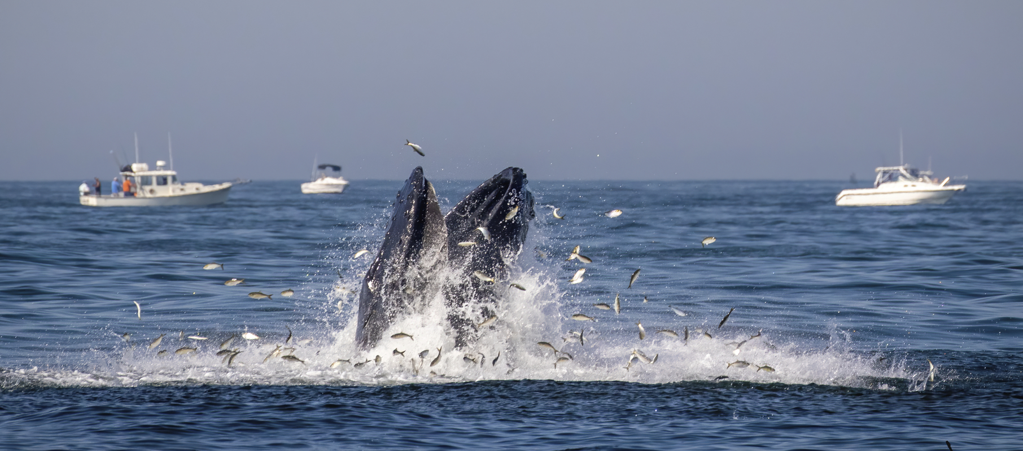
For Feeding Whales, It’s Always:
“Eyes on the Prize”
Give feeding whales extra space & time
Slow down when you see signs of feeding activity
Never assume a whale can get out of your way
Respect their need to feed in peace
Notes:
A feeding whale can have up to 5,000 gallons of water in its throat—that's 40,000 pounds! Even if whales want to move away from your vessel, they become relatively immobile and physically cannot.

Slide 11
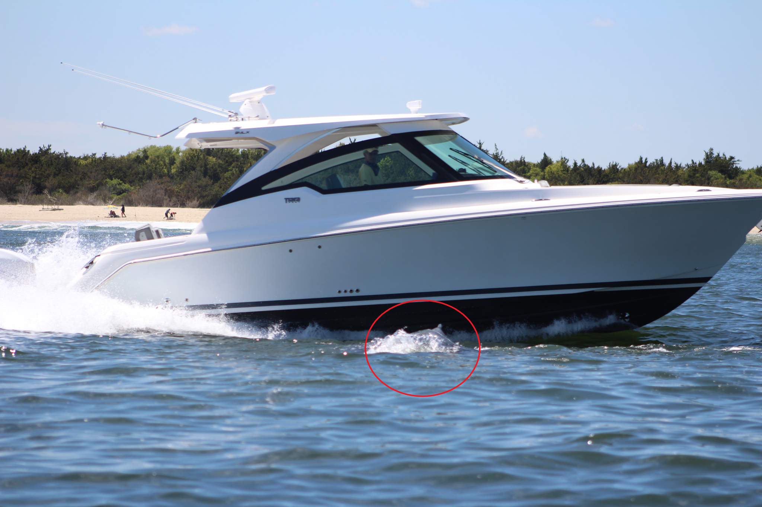
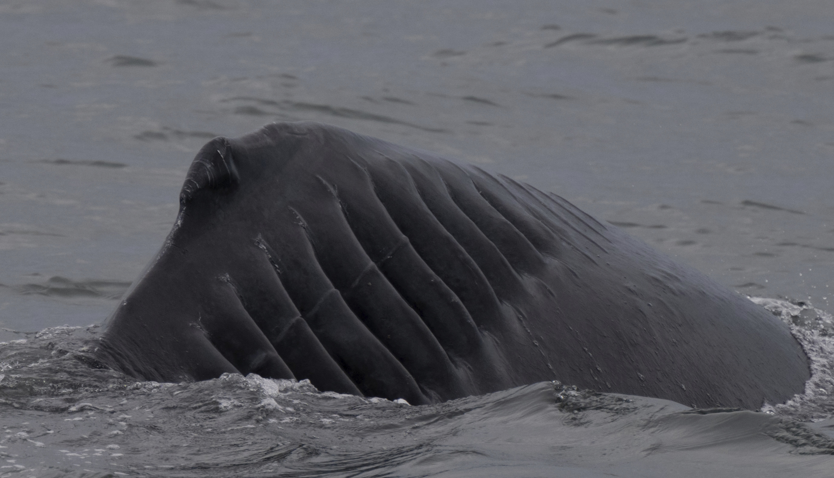
All Vessels Pose a Risk
Fast-moving boats are dangerous!
Both large commercial and small recreational vessels can injure or kill whales.
Even sailboats pose a risk.
Many injured and dead whales were hit by small, recreational boats.
The Bottom Line: ANY vessel—big or small—can cause serious injury or death to a whale.
Notes:
Think your boat is too small to harm a whale? Think again. Pro Tip: When operating your vessel, employ the same level of caution that you would if you saw swimmers or other potential hazards in the water, for the safety of your vessel and crew, and the whales sharing our waters!

Slide 12
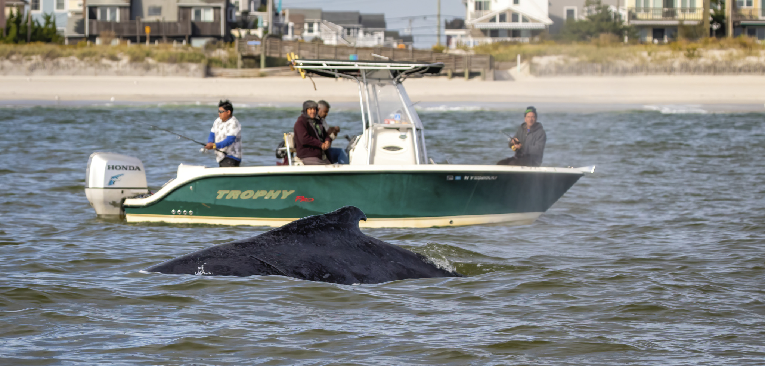
1. Power Down
Slow down or come to a complete stop, and bring gear & lines into vessel.
Alert your crew to help watch for whales.
Ensure good visibility from your vessel.
2. Keep a Lookout
Don't rush—assess the situation carefully.
Treat whales with the same caution you'd use around other hazards or swimmers.
Operating Safely Around Whales
3. Wait Patiently
4. Resume Course Safely
Only proceed when you’re confident it’s safe.
Notes:
If you spot any signs of whales in the area, immediately take the precautions mentioned here. Operating your vessel as if you are navigating near swimmers who don’t see you can save lives and prevent injury.

Slide 13
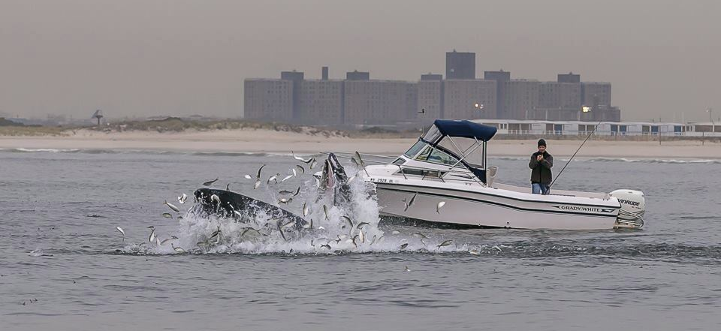
Operating with Whales in Sight
Pull in Your Gear
Remove anything that could entangle the whale.
Reel in fishing lines immediately.
Follow These Rules
Keep Your Distance: Do not chase, follow, or crowd the whale.
Do Not Feed: Feeding marine mammals is illegal.
Avoid Threatening Moves: Don't place yourself directly in front of the whale or approach head-on.
Proceed Cautiously: Move slowly, pay attention to your surroundings, and depart when it's safe.
Notes:
Once you’ve confirmed whales are present, follow the critical steps mentioned here.

Slide 14
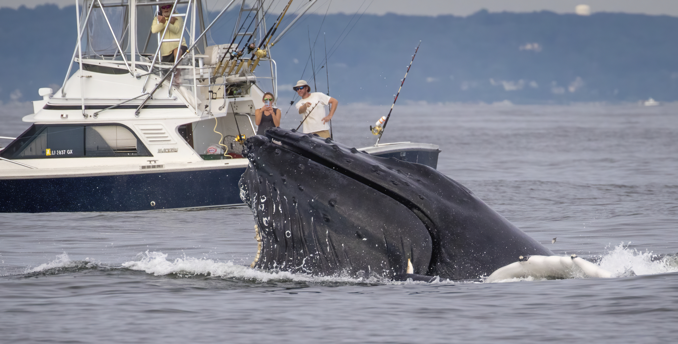
If a Whale Approaches You
Immediate Actions
Put your engine in neutral to avoid accidental harm.
Do not re-engage your engine until you see the whale surface and determine which direction it's moving.
Departure
Proceed slowly and cautiously away from the whale.
Maintain a safe distance before resuming normal speed.
Move parallel to or toward the rear of the whale.
Notes:
Whales are intelligent and curious—they may approach your vessel. Here's how to respond. Remember: A whale's tail may be just the tip of the iceberg. What isn't visible above the surface may be right under your boat!

Slide 15
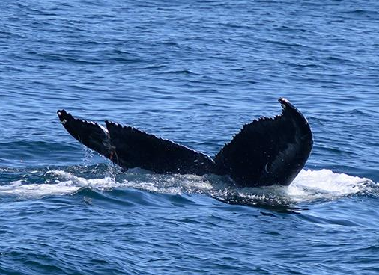
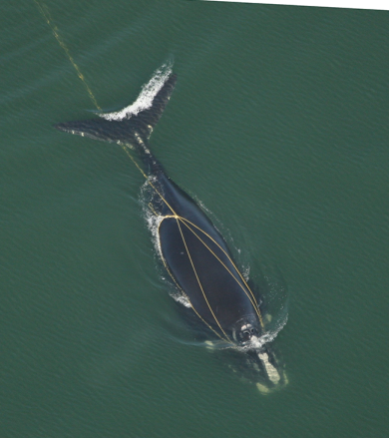
Entanglement
One of the leading causes of harm and death to whales in our waters. The consequences:
Exhaustion
Infection
Increased risk of vessel strikes
Restricted movement and inability to dive
Drowning
Starvation
Recreational
Fishing Gear
Commercial
Fishing Gear
85% of all North Atlantic right whales have scars showing they’ve been entangled at least once in their lives.
Notes:
Entanglements are one of the most serious threats to whales in our waters. Fishing gear—like the tuna fishing lure and lines shown entangled around the whale fluke on the left (recreational), as well as commercial lines (shown on the right), and nets and traps—often ensnare whales, sometimes for months or years.
Entanglement: Whales swim into lines and nets that wrap tightly around their tails, flippers, or mouths. Being trapped near the surface increases their chances of vessel strikes.
Chronic Injury: Heavy gear causes deep cuts, infections, and long-term pain that weakens the animal over time.
Drowning: Trapped whales often cannot swim to the surface to breathe, leading to suffocation.
Hunger: Gear drag prevents whales from hunting food effectively, causing starvation.

Slide 16
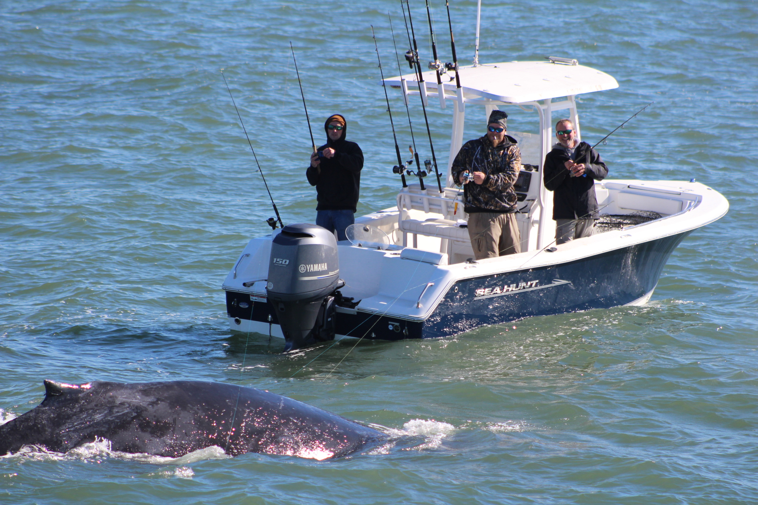
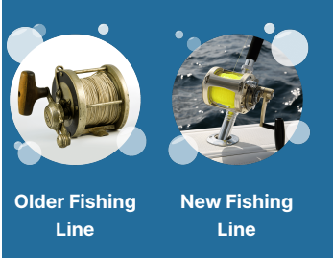
Fishing Responsibly
Around Whales
Today's monofilament and braided lines are much stronger than older gear
They're harder to break—great for fishing, but dangerous for marine life
Even recreational hook-and-line gear can inflict life-threatening wounds
Fishing Lines
No Run
& Gun
No Bubble Casting
No Dead Sticking
Pull Gear In
Don't race toward diving birds or bait schools when whales are near
Don't cast into or troll over bubbles in the water
Don't leave unattended lines when whales are close
Reel in lines immediately if a whale gets close
Notes:
Think your single fishing rod isn't a problem? Think again. Today’s lines are much stronger than they used to be.Here’s a review of precautions you can take to share waters responsibly when fishing in the same waters as whales. Can you think of other precautions you can take?

Slide 17
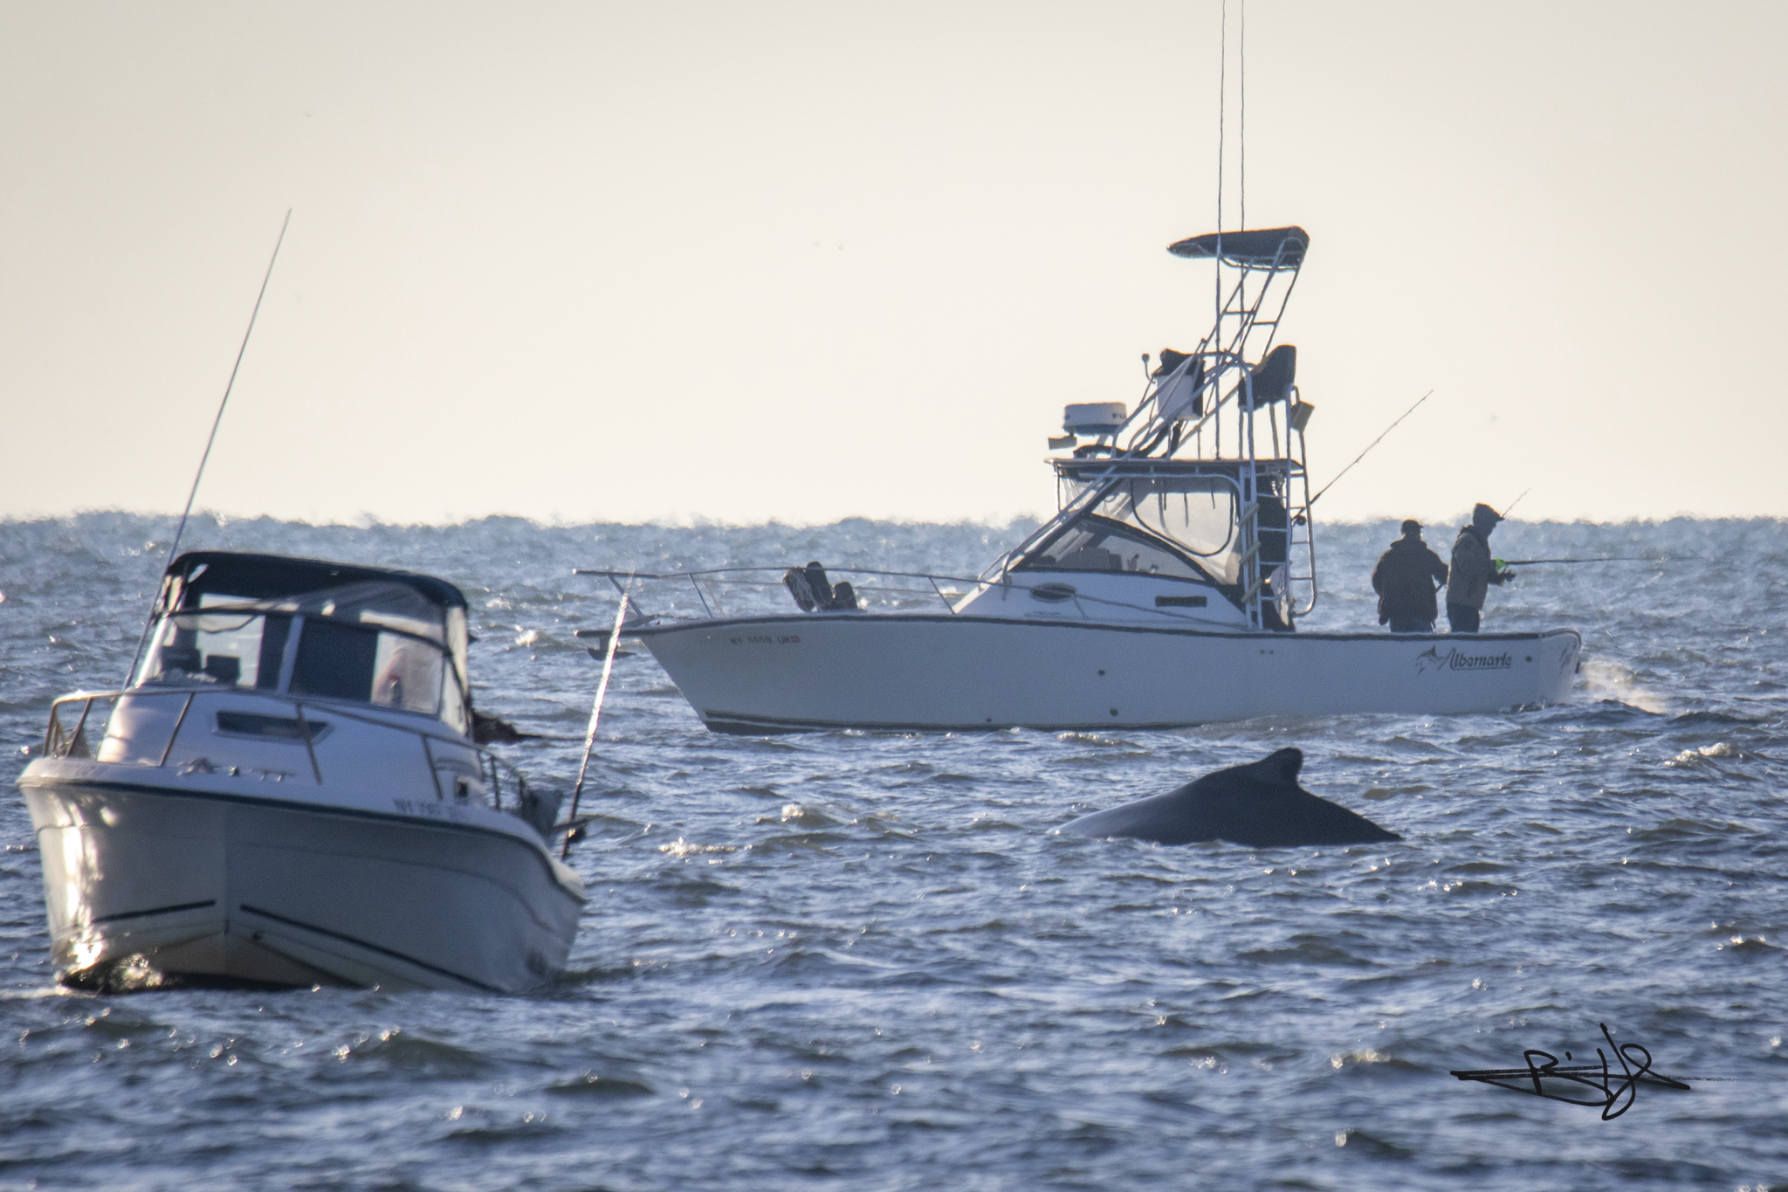
Legal Requirements
Federal Law Prohibits
Harassing, feeding, chasing or disturbing marine mammals
Violations can result in significant fines
100 feet minimum: Most other whale species (federal guidance)
Give more room for active whales: A breaching whale can sink your boat!
Required Distances
150 feet minimum: Seals, dolphins and sea turtles
1,500 feet minimum: North Atlantic right whales (legal requirement)
Pro Tip: Use your boat length to gauge distance. For example, if you have a 25-foot boat, 4 boat lengths equals 100 feet.
Notes:
When it comes to whales and marine life, giving them space isn't just polite—it's the law. Even if you are complying with the law, if you and a whale collide, it can spell danger for you, your crew and vessel, and the whale!

Slide 18
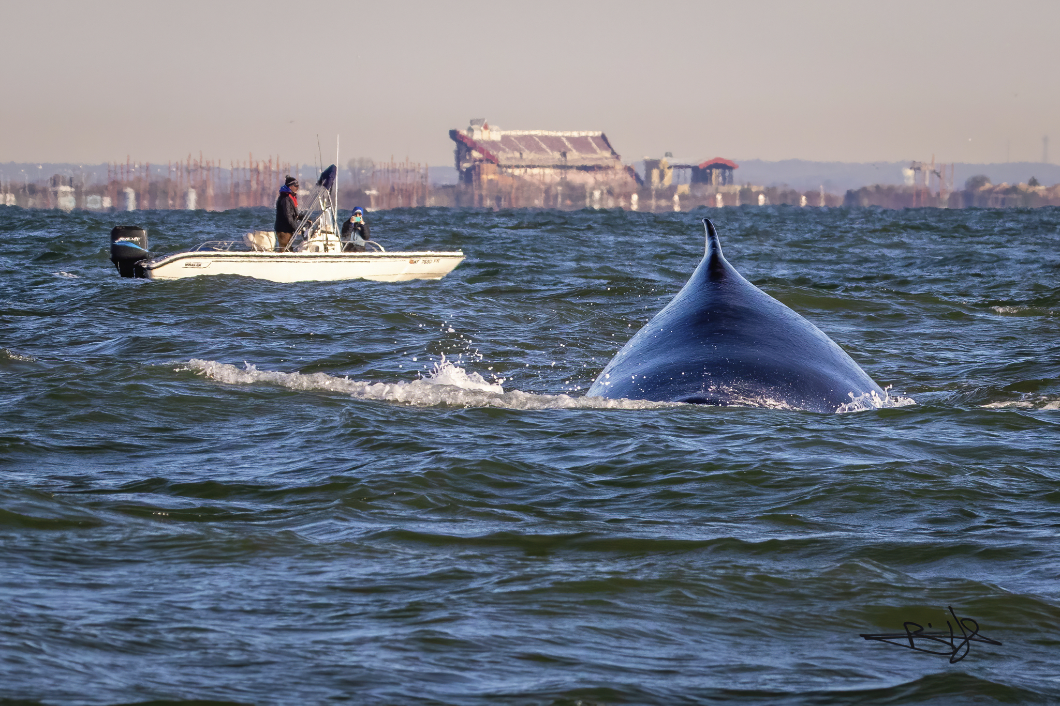
Best Practices
Spend ≤30 minutes observing a particular group
Don't approach if other vessels are nearby—multiple boats increase stress
Alert other boaters via VHF radio
Limit Viewing Time
Don’t touch or feed
Don't chase, pursue or encircle
Never trap whales between your boat & shore
Stay far away when calves are present—never separate mothers from calves
Avoid Disturbing Whales
Slow down if a whale is nearby
Put your engine in neutral when whales approach
Steer parallel to or toward the rear of animals
Never change direction abruptly
Proceed Cautiously
Notes:
Once you’ve confirmed whales are present, follow the critical steps mentioned here. It could make all the difference to you, your crew, your vessel and the whales around your boat.

Slide 19
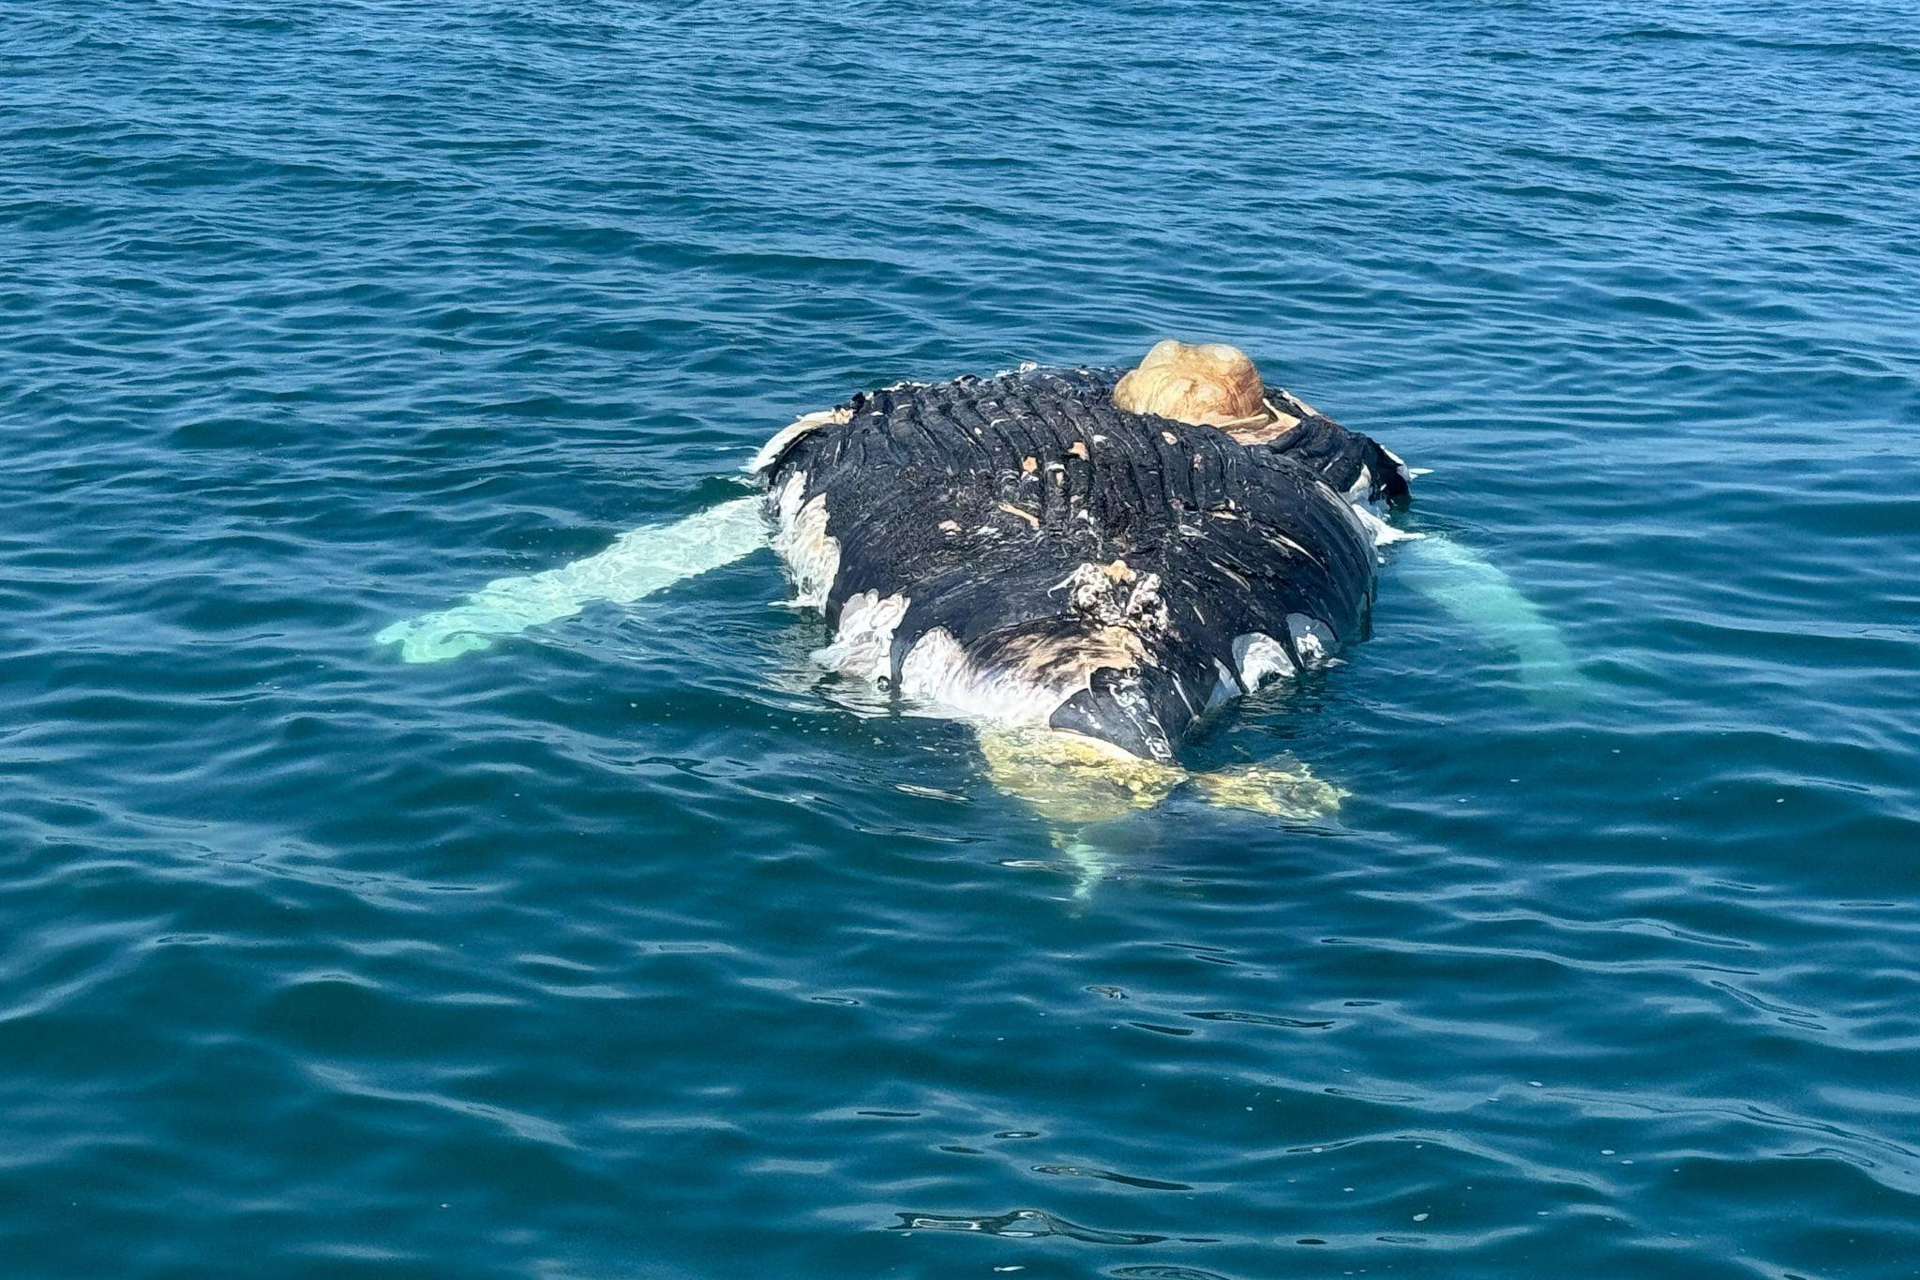
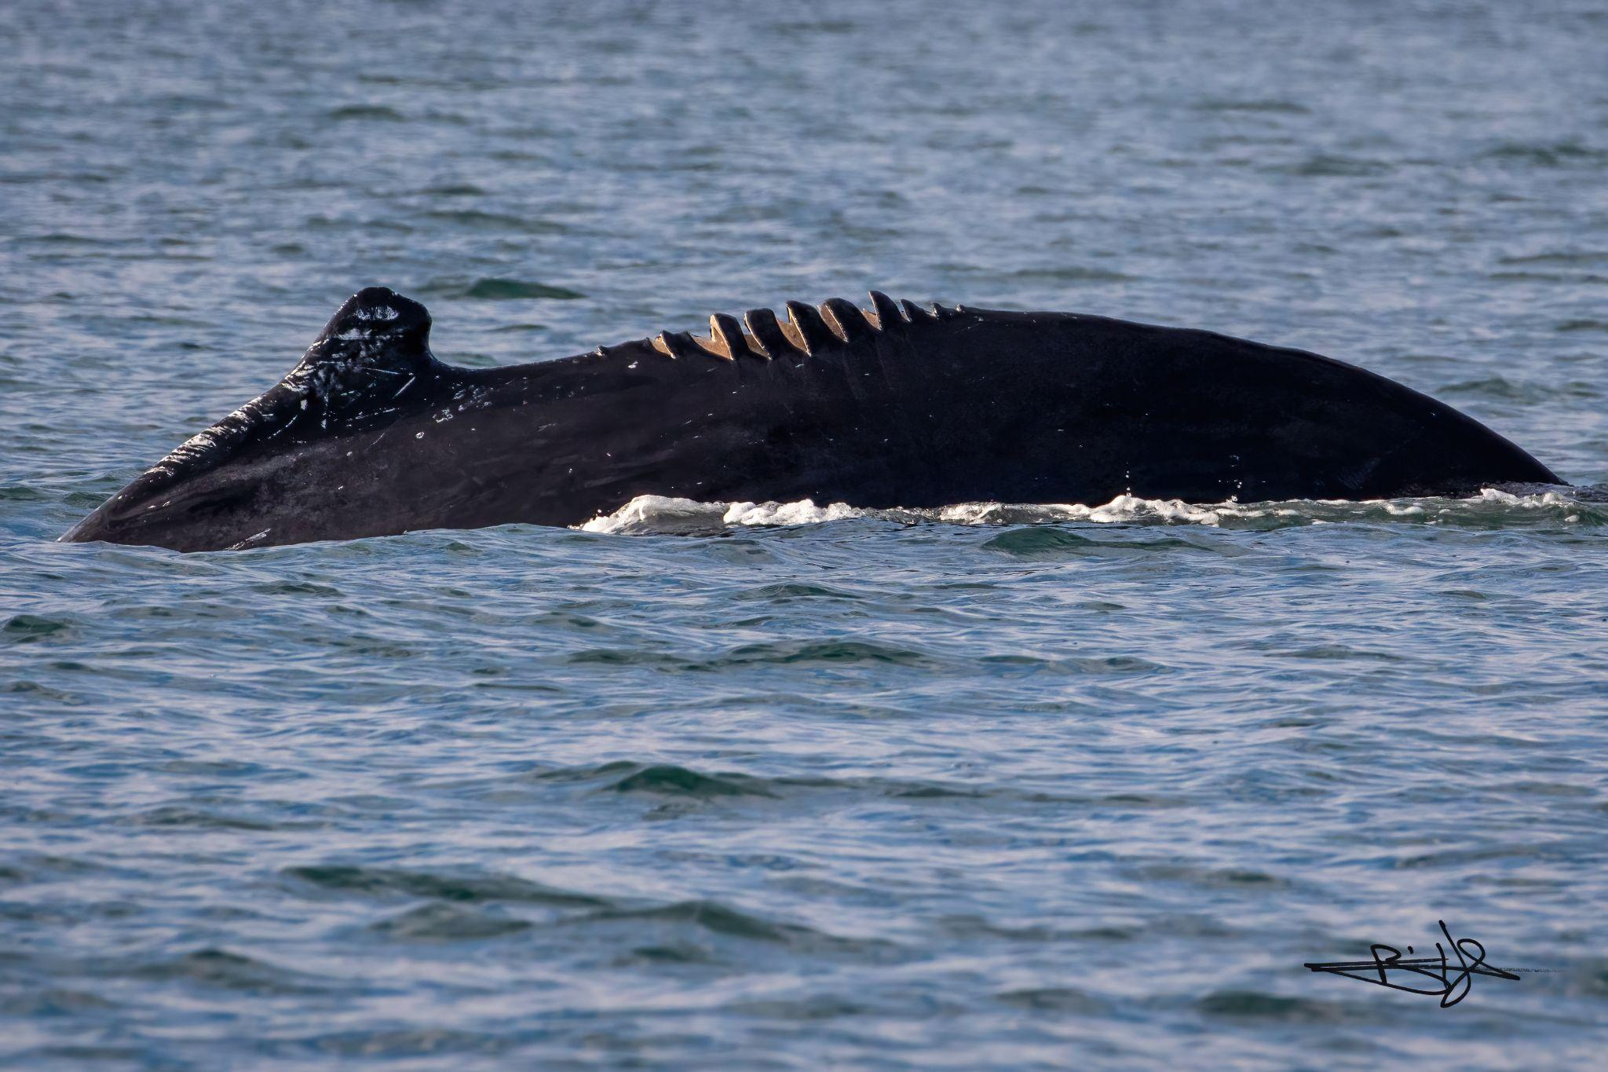
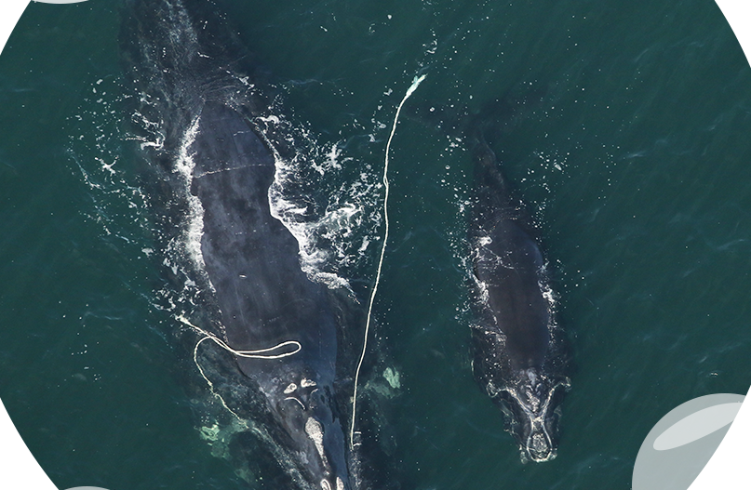
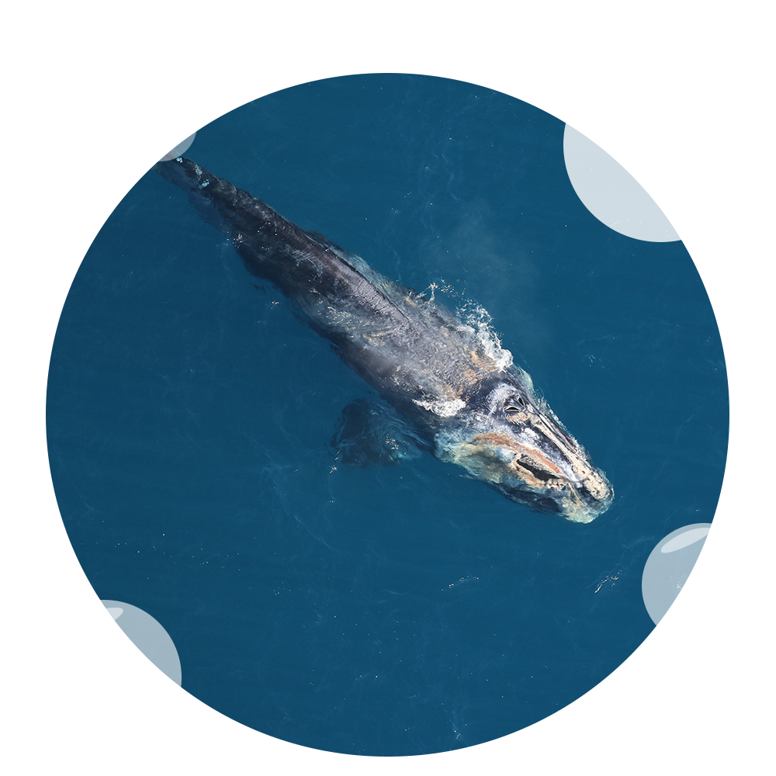
Report Whale Sightings
Dead
Make these 3 calls immediately if you see whales that are dead, injured, entangled or sick:
U.S. Coast Guard via VHF Radio Channel 16
Marine Mammal and Sea Turtle Stranding Hotline In NY: 631-369-9829
NOAA's Stranding Hotline: 866-755-6622
Injured
Entangled
Pro Tip: Add these contacts to your phone now!
Sick
Notes:
General whale sightings are helpful to document, but immediate reporting is critical for dead, entangled, injured or sick whales. (*click here for numbers for outside NY*)

Slide 20
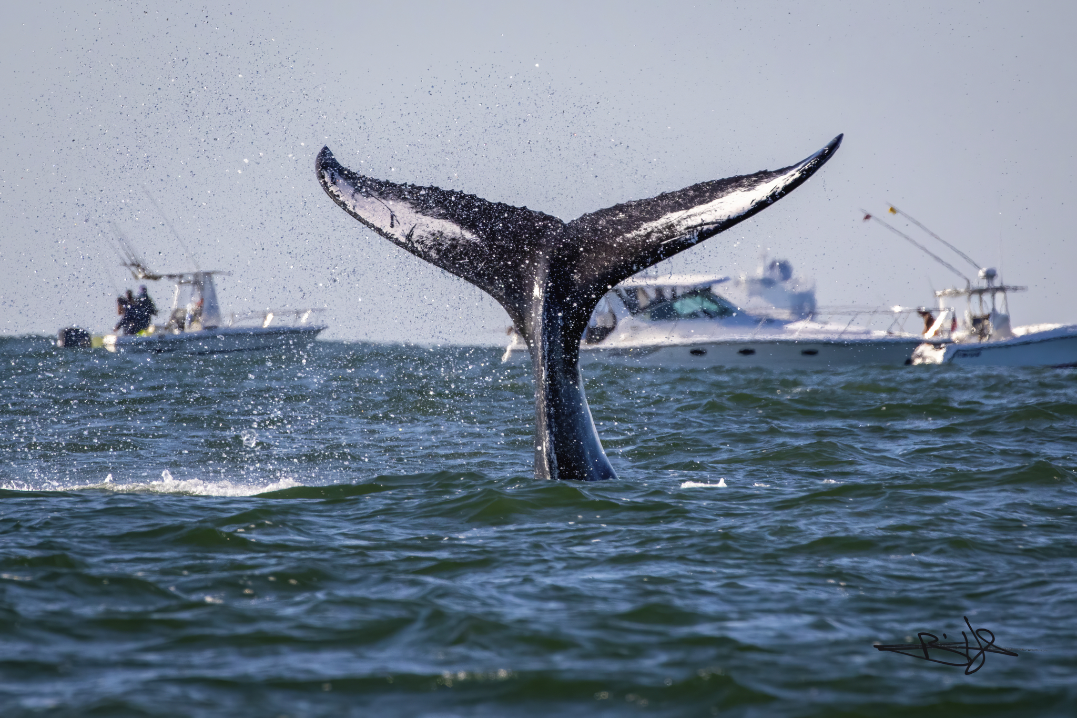
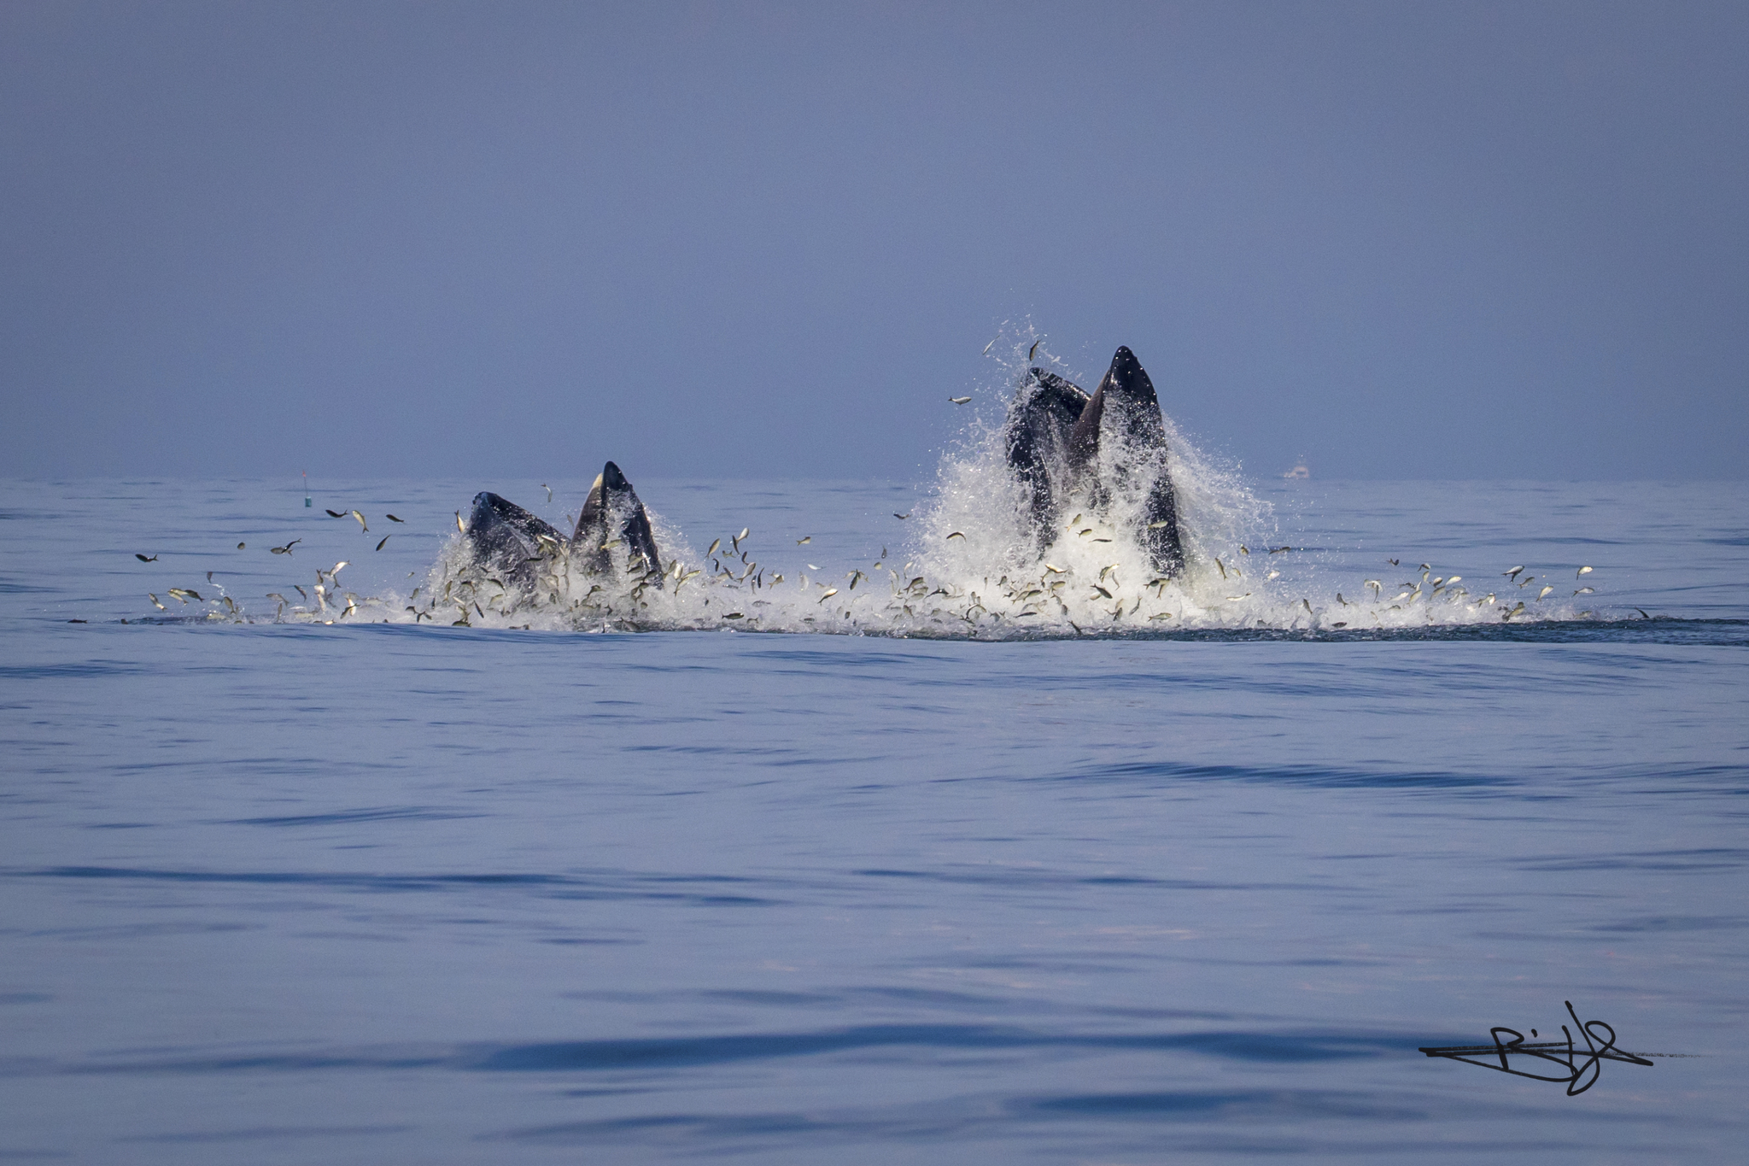
Your Role in Ocean Conservation
Keep your eyes on the water & watch for whale signs
Maintain safe distances & follow all federal regulations
Use the Whale Alert app for real-time information
Report sightings of entangled, injured or distressed whales
Teach your family & friends what you've learned
Model responsible boating practices every time you're on the water
Notes:
Every outing is a chance to spot something amazing—and to make a difference for whales and our marine ecosystem.Remember: By being a whale-wise boater, you're not just protecting whales—you're ensuring that future generations can experience the wonder of these magnificent creatures in New York's coastal waters.

Slide 21
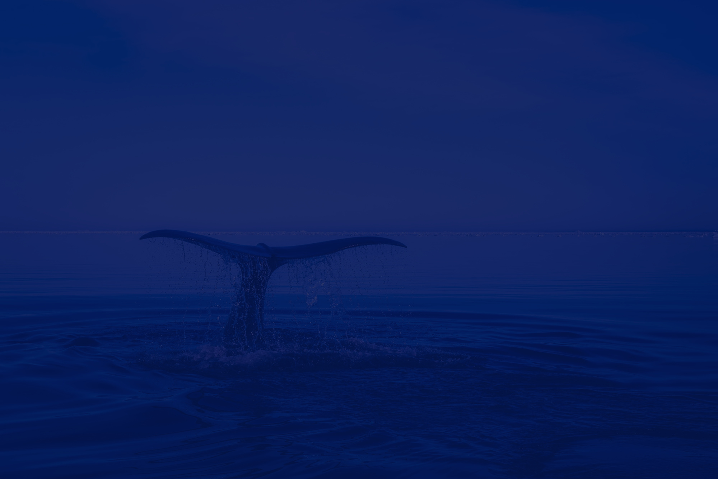
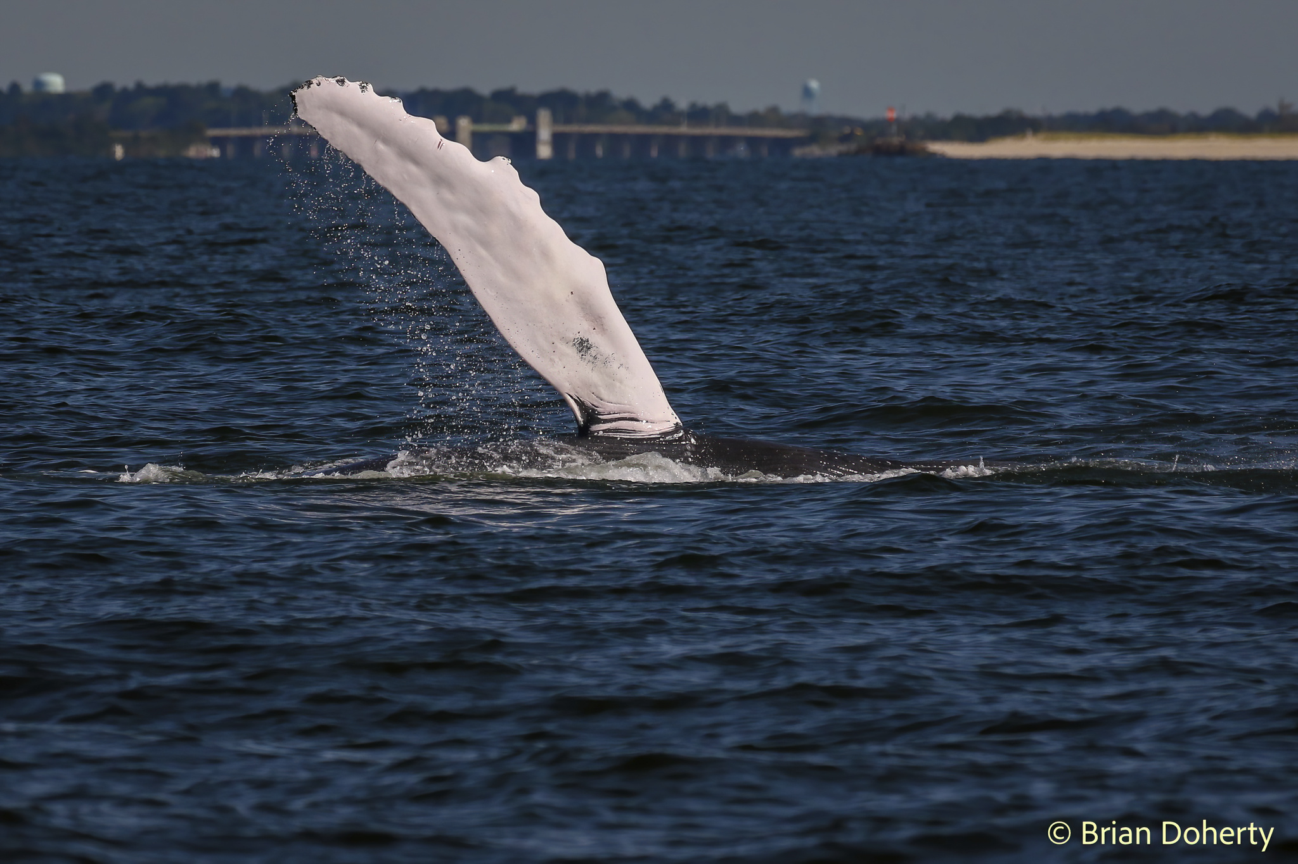
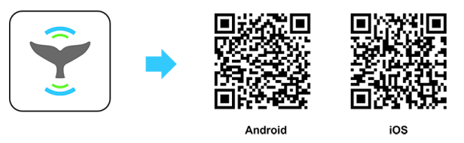
Resources
State-Specific Marine Stranding Numbers
ME: 800-532-9551
NH: 603-997-9448
MA: 800-900-3622
RI/CT: 860-572-5955 x 107
NY: 631-369-9829
NJ: 609-266-0538
DE: 302-228-5029
MD: 800-628-9944
VA: 757-385-7575
NC: 910-515-7354
SC: 800-922-5431
GA: 912-269-7587
FL: 888-404-3922
24-hour NOAA Stranding Hotline for all of the Atlantic: 866-755-6622
Scan QR code to download the Whale Alert App
or go to www.boatingwithwhales.com
+123-456-7890
@reallygreatsite
www.reallygreatsite.com
123 Anywhere St, Any City
Notes:
Recommendations: Be sure to add the relevant numbers to your phone contacts. Take the Boating With Whales course. Download the Whale Alert app before heading out for relative real-time whale sightings, management zone information, current marine mammal activity and safety recommendations.

Slide 22
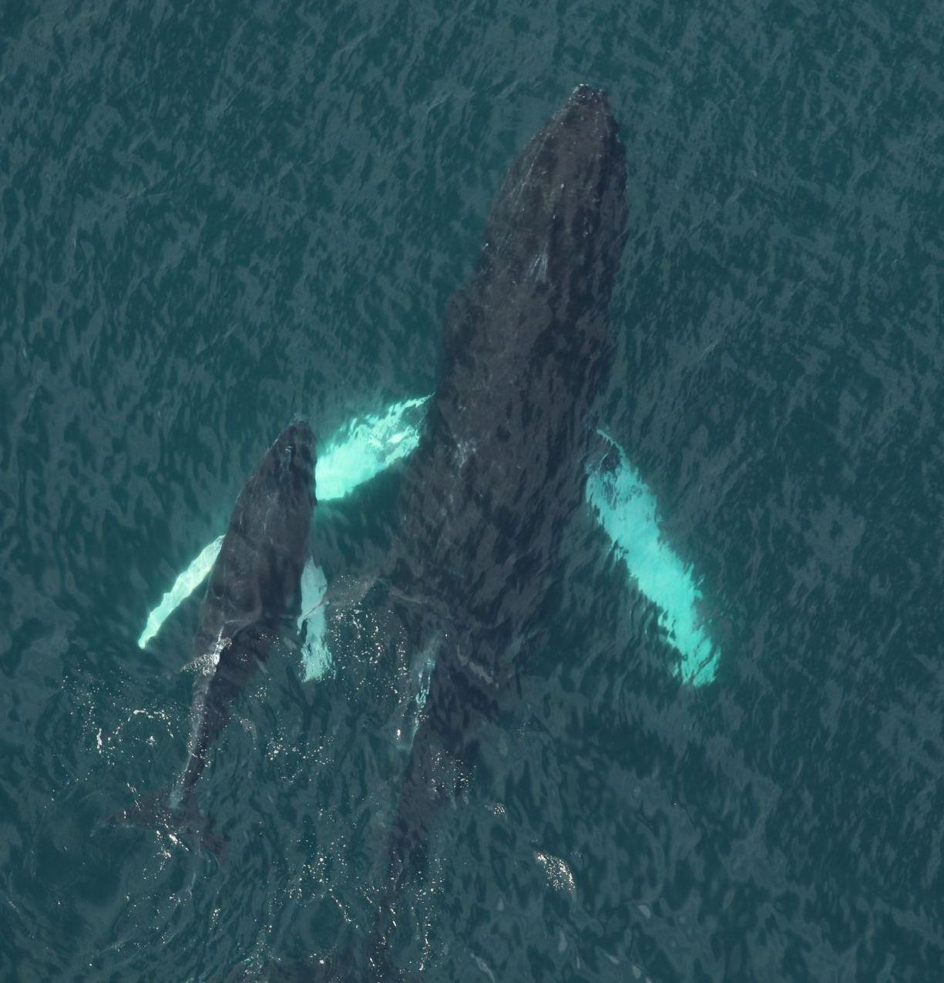
Acknowledgements
Created by The Nature Conservancy with contributions from
Atlantic Marine Conservation Society
Coastal Research & Education Society of Long Island
Gotham Whale
National Oceanic & Atmospheric Administration
New York State Department of Environmental Conservation
Wildlife Conservation Society
Michael Busch
Brian Doherty
+123-456-7890
@reallygreatsite
123 Anywhere St, Any City

